Slide 1
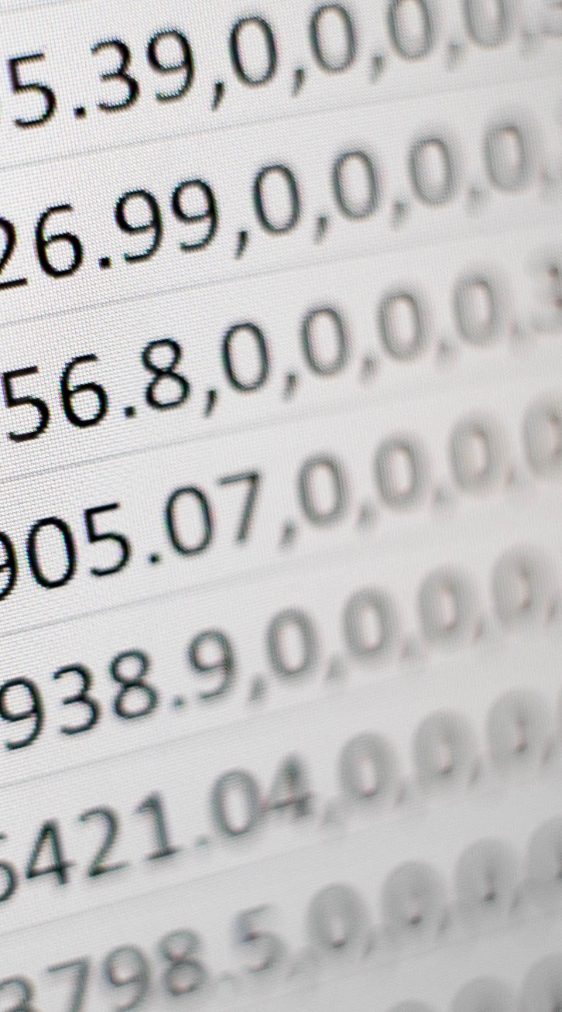
Business Case
High-Frequency Algorithmic Trading With Deep Learning
Ritesh Kumar

Slide 2



OBJECTIVES
Develop Advanced Algorithmic Trading System
Leverage High-Frequency Data and Technical Indicators
Improve Trading Efficiency and Profitability
The project aims to develop an advanced algorithmic trading system for BankNifty, a major Indian banking index, using deep learning techniques.
The system will leverage high-frequency data and various technical indicators to make informed trading decisions, enhancing trading efficiency and profitability.
The goal is to ultimately enhance trading efficiency and profitability through the use of this advanced algorithmic trading system.
This project presents a comprehensive business case for leveraging high-frequency algorithmic trading with deep learning techniques to drive improved trading performance for trading in the BankNifty index.

Slide 3



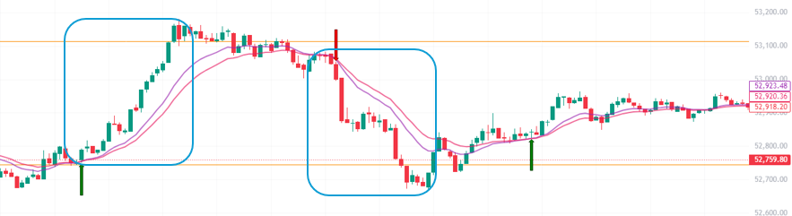
HYPOTHETICAL TRADING SCENARIO
Initial Investment
Intraday Movements Captured
Predictions and Stop-Loss
Net Profit and Return
The trader invests Rs. 100,000 in the BankNifty index using the developed algorithmic trading system.
The algorithm successfully captures three intraday movements of approximately 100 points each over two trading days.
The algorithm correctly predicts two out of the three movements and applies a stop-loss on the third movement.
The net profit over the two-day period is Rs. 11,250. Extrapolating this to 20 trading days in a month, the total profit would be Rs. 112,500. After deducting the expenses for data subscriptions and cloud services, which total Rs. 27,000, the net profit would be about Rs.85,000.

Slide 4
BENEFITS
Increased Profitability
The proposed trading system utilizes deep learning algorithms to identify and capitalize on market opportunities, leading to higher returns and improved bottom line.
Risk Mitigation
Advanced risk management techniques and real-time monitoring allow the system to quickly identify and mitigate potential risks, protecting the portfolio from market volatility.
Efficiency
Automated trading and decision-making processes reduce the time and effort required to manage the portfolio, freeing up resources for other strategic initiatives.
Scalability
The system's ability to handle large volumes of data and execute trades at high frequencies enables the business to grow and expand its trading operations without compromising performance.
Competitive Advantage
By leveraging cutting-edge technology and advanced analytics, the proposed trading system provides a strategic edge over competitors, allowing the business to stay ahead in the rapidly evolving financial market.

Slide 5





IMPLEMENTATION PLAN
Phase 5
Phase 1
Deploy the high-frequency algorithmic trading system to the live trading environment and monitor its performance.
Collect and preprocess historical market data for training and testing the deep learning models.
Phase 3
Integrate the deep learning models with the trading platform and system.
Phase 2
Phase 4
Develop and train deep learning models for high-frequency algorithmic trading strategies.
Conduct extensive testing and optimization of the trading strategies to improve performance and stability.

Slide 6




FINANCIAL PROJECTIONS
Expected Annual Return on Investment (ROI)
85%
12%
<5%
High-Frequency Algorithmic Trading with Deep Learning
Traditional Trading Methods
Savings Account

Slide 7
Thank You

